Slide 1
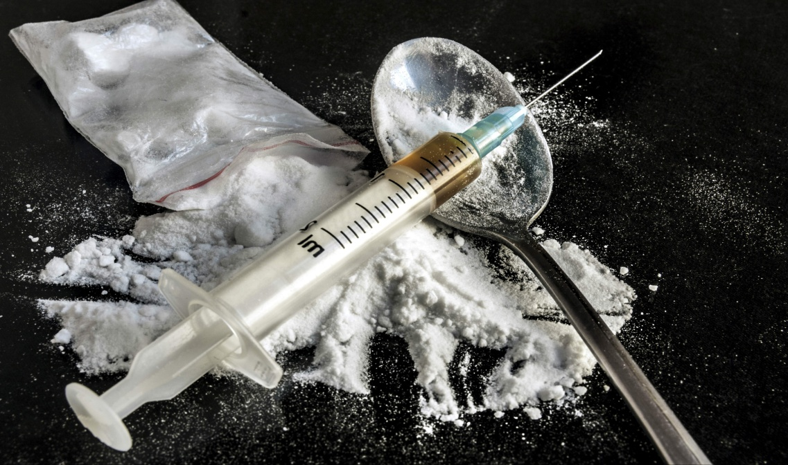

PREDICTION ON EFFECTIVENESS OF DRUG TREATMENT
Name : Ashutosh Gopal Sureka
NetID: asure4

Slide 2
INTRODUCTION
How to treat drug users is a controversial and timely issue currently in the United States. In the last 15 or so years, an increasing amount of convicted drug users have been given the option (or have been required) to complete a drug treatment program instead of serving time in prison. Completing treatment instead of spending time in jail have many psychological, financial, health and social benefits.

Slide 3
Many questions surround the current state of drug
treatment:
Are these programs helping drug users return to productive lives?
Who is likely to succeed and complete these programs and who isn't?
What type of treatment is right for a specific individual and will they adhere to program guidelines?
Are there certain demographic groups for whom drug treatment is not working?

Slide 4
Having data driven insights to help answer these
questions can have many practical benefits:
More efficient use of public and private financial resources
Individually tailored treatment programs to increase probability of successful treatment
Identification of high risk individuals
Identification of high performing state drug treatment programs
Besides the possible practical benefits of the analysis of the dataset, the size and scope of dataset present many interesting computational challenges.

Slide 5
DATA SOURCE
The data includes demographic, geographic, education
and employment, drug use history, and treatment
program outcome information for approximately 9.8
million treatment episodes between the years 2006 and
2011. The data does not contain information relating to
drug use relapse after the termination of the treatment
episode.

Slide 6
The data is made public by the Substance Abuse &
Mental Health Services Administration (SAMHSA) and
the data is hosted by the Inter-university Consortium for
Political and Social Research (ICPSR). The data consists
of 65 features, most of which are entirely categorical.
The specifics relating to the data are described in greater
detail in the section on exploratory data analysis.

Slide 7
The data can be downloaded from the below link :
http://www.icpsr.umich.edu/icpsrweb/ICPSR/studies/30122

Slide 8
PROJECT OBJECTIVES
PRACTICAL :
Predict whether new drug treatment episode will conclude positively
Predict the probability of positive conclusion of a new treatment episode
Understand the drivers of successful drug treatment
Identify profiles of drug users particularly vulnerable to non-completion of treatment
Distinguish between state treatment program adherence rates

Slide 9
COMPUTATIONAL :
Determine which machine learning algorithm(s) are most suited to this dataset and objective
Determine the best evaluation method for model predictions
Formulate baseline predictions to compare to model predictions
Explore variable importances and incorporate findings into model(s)
Identify limitations of final model and analysis

Slide 10
PROPOSED HYPOTHESIS
A drug treatment program administrator could identify
the different probabilities of completion of a variety of
treatment programs for a given individual and, in turn,
make an informed decision that could lead to more
efficient use of resources.

Slide 11
ANALYSIS METHODOLOGY
Data Cleaning
Elimination of not applicable features
Dealing with missing values
Dropping specific participant records
'Most Frequent' value imputation
Imputation of missing values using random forests
Prediction
Random forest classifier
Results
Fit unregularized logistic regression model to the proposed base model
Make final predictions and evaluate results

Slide 12
CONCLUSION
A crucial assumption made that could have affected
model performance was to group transferred
participants together with participants who completed
treatment. Although they are both 'positive' conclusions
to treatment, they are quite different results. Model
performance could be improved through further
investigation of the causes for transferring participants
and possibly implementing a ternary response variable
(completed, transferred, not completed).

Slide 13
Although there was a significant improvement upon the
baseline models, the overall model still struggles with the
outcome prediction for some individuals. There are many
other factors that can contribute to treatment completion.
Including data relating to family ties (contact with parents,
having brothers and sisters) could help improve the model.
As to protect the anonymity of the treatment providers, the
dataset provided limited information about details from the
treatment program. Data relating to treatment program
affiliation (private, public, faith based) as well as program details
such as amount of time in contact with health professionals and
psychiatric care could also increase the accuracy of the model.

Slide 14


